Slide 1
Fundamentals of Algorithm (FA)
Omkar Basnet
Academic Incharge , CSIT/BCA
Texas international college

Slide 2
Chapter one (6 teaching hours)
Introduction to algorithm
Implementation issues
(completeness, time and space complexity, optimality)
Implementation issues with data structure
Errors and implementation of API
Analyzing algorithms
Scientific , mathematical and theory of computation

Slide 3
Introduction to algorithm
An algorithm is the well defined computational procedure that takes some values , set of values as input and produces some values or set of values as output.
Or
An algorithm is the sequence of computational steps that transforms the input intro the input into output.

Slide 4
Characteristics of algorithm
Input : must take some inputs
Output : must produce output after providing set of inputs
Definiteness : each steps must be clear and unambiguous
Finiteness : must terminates after some finite steps.
Effectiveness : each step must be carried out in finite time.

Slide 5
Implementation issues
We need designing and implementation concepts of an algorithm because there are multiple algorithms to solve the single problem.
After getting the proper knowledge we can easily select proper algorithm among available by analyzing the different performance measures.

Slide 6
Implementation issues
Completeness: An algorithm is said to be complete if it definitely finds solution to the problem, if exist.
Time Complexity: How long (worst or average case) does it take to find a solution? Usually measured in terms of the number of nodes expanded
Space Complexity: How much space is used by the algorithm? Usually measured in terms of the maximum number of nodes in memory at a time
Optimality/Admissibility: If a solution is found, is it guaranteed to be an optimal one? For example, is it the one with minimum cost?

Slide 7
Implementation issues with data structure
What is data structure?
Data structure is a way of organizing all data items and establishing relationship among those data items.
Data structures are the building blocks of a program.
Data structure mainly specifies the following four things:
Organization of data.
Accessing methods
Degree of associativity
Processing alternatives for information

Slide 8
Implementation issues with data structure
To develop a program of an algorithm, we should select an appropriate data structure for that algorithm.
Therefore algorithm and its associated data structures form a program.
Algorithm + Data structure = Program
“While managing the data structure in program design we must be able to analyze the processing time of static and dynamic data structure along with the object oriented concept such as inheritance , encapsulation , errors and exceptions etc.”

Slide 9
Errors and implementation of API
Assignment 1#
What are the errors that arises while implementing the algorithm?
What is API? Why it is important in effective programming ? Explain the implementation procedure of API in programming.

Slide 10
Analyzing algorithms
The analysis of algorithm gives good insight of the algorithm.
It basically deals with the process of analyzing time and space complexity, after designing the algorithm with the capability of handling large amount of data.
Then programmer must answer the following questions:
Is the algorithm correct?
The algorithm generates the required result or not?/ Does the algorithm terminates for all the inputs under problem domain?
How long will my program take to execute completely?
Why my program runout memory?

Slide 11
Analyzing algorithms
To answer these questions there is scientific method/model which includes following operations:
Observe some features generally with precise measurement.
Hypothesize a model that is consistent with the observation.
Predict event with hypothesis.
Verify the predictions by making further observations.
Validate by repeating until the hypothesis and observation agree.

Slide 12
Analyzing algorithms
The scientific model can be analyzed in java programming by analyzing the time complexity by built in function stopwatch.java , which evaluates the complete runtime of program.
Public class stopwatch {
Stopwatch() // creates stopwatch
Double elapsedTime() // return elapsed time
The time is measured by threesum.java function

Slide 13
Analyzing algorithms
The Mathematical model
In mathematical model we basically focus on two terms :
Tilde Approximation
Order of growth classification.
Tilde approximation discards lower order term of a complexity function to simplify the problem and order of growth is calculated by analyzing the power associated with variable.

Slide 14
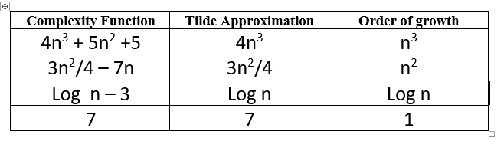
Analyzing algorithms
The Mathematical model
For eg:

Slide 15
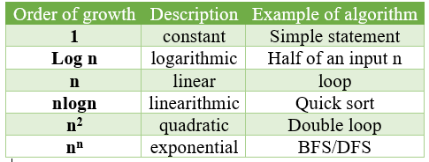
Analyzing algorithms
Different types of order of growth:

Slide 16
Analyzing algorithms
Theory of algorithm
GOAL : establish difficulty to the problem and develop optimal algorithm.
Where the analysis of algorithm is done in three ways:
Best case
Average case
Worst case

Slide 17
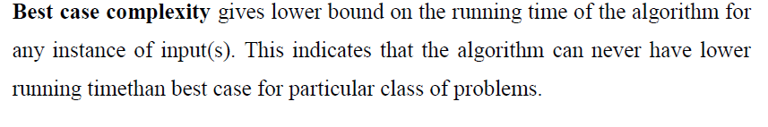
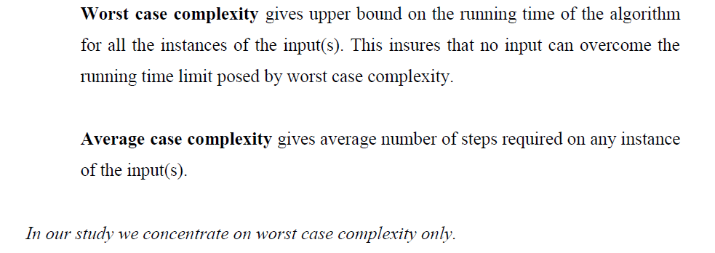
Analyzing algorithms
Theory of algorithm

Slide 18
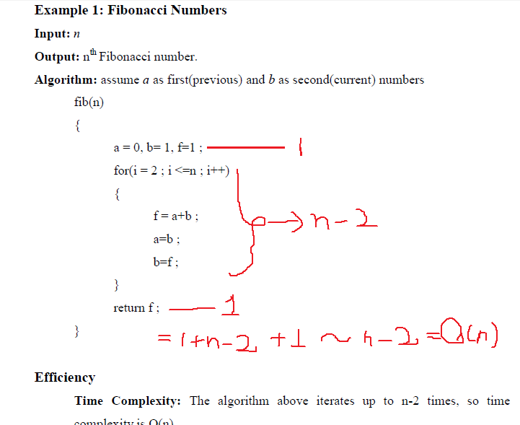
Analyzing algorithms

Slide 19
Analyzing algorithms
Theory of algorithm
The analysis of algorithm can be done by using asymptotic notation to get mathematical function of best, worst and average case.the asymptotic notations are:
Big O (worst case)
Big Omega (Best Case)
Big Theta (average case)

